Slide 1
Introduction to STREAMLIT
R S HARIPRASAD

Slide 2
What is Streamlit?
Streamlit is an open-source Python library used for building and sharing custom web apps for machine learning and data science entirely in Python, without requiring frontend development skills like HTML, CSS, or JavaScript.

Slide 3
Why Streamlit Is Needed for This Project
Streamlit is used in AI chatbot projects because it helps us for quickly build a clean, interactive web interface without needing complex frontend coding. For our project BankBot – AI Chatbot for Banking FAQs, Streamlit makes development fast, simple, and user-friendly.
Simple UI Creation: Streamlit makes it easy to build a chatbot interface without using HTML, CSS, or JavaScript.
Fast Prototyping: You can quickly create and test your chatbot with minimal code, ideal for student projects.
Easy Integration: It connects smoothly with Python NLP models, APIs, and ML scripts used in BankBot.
Real-Time Interaction: Streamlit handles instant user input and displays chatbot responses immediately.
Clean and Professional Look: It automatically provides a neat chat-style interface suitable for demonstrations.
Easy Deployment: You can deploy the chatbot easily using Streamlit Cloud or simple hosting platforms.

Slide 4
Streamlit Installation
To install Streamlit, open a terminal or command prompt and run the command pip install streamlit
After the installation completes, we can test it by running streamlit hello which will launch a demo app in your web browser.

Slide 5

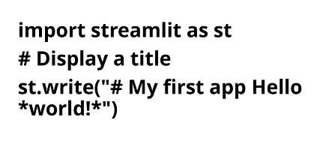
Creating of Basic Streamlit app

Slide 6
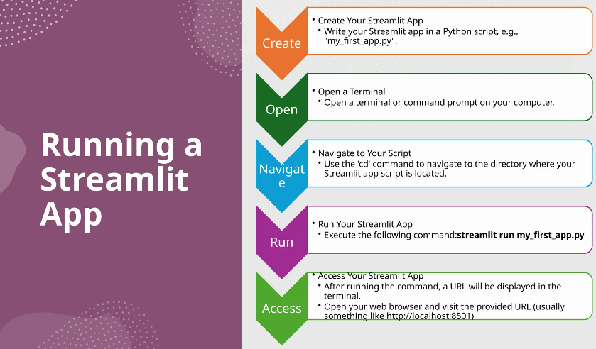

Slide 7
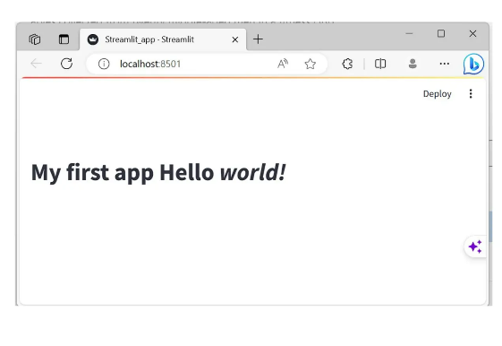


Slide 8


